Slide 1
Understanding prototypal inheritance in JavaScript
by a mad guy who believes he can explain prototypes…
Notes:
Hi there!
I’m Martin. You know guys when you start working on a project and you have a working title. It’s not the final one, but the one you use to explain what you are doing. Well … this is the working title that actually got to production ☺
A few words about the “mad guy”

Slide 2

Who am I?
Front-end Technical Leader
Programming enthusiast
Software designer
Notes:
Post presenting myself…:
Actually in these 4 words (state the words) there is quite a lot of stuff, so let’s split them a bit and start by understanding what inheritance really means.

Slide 3
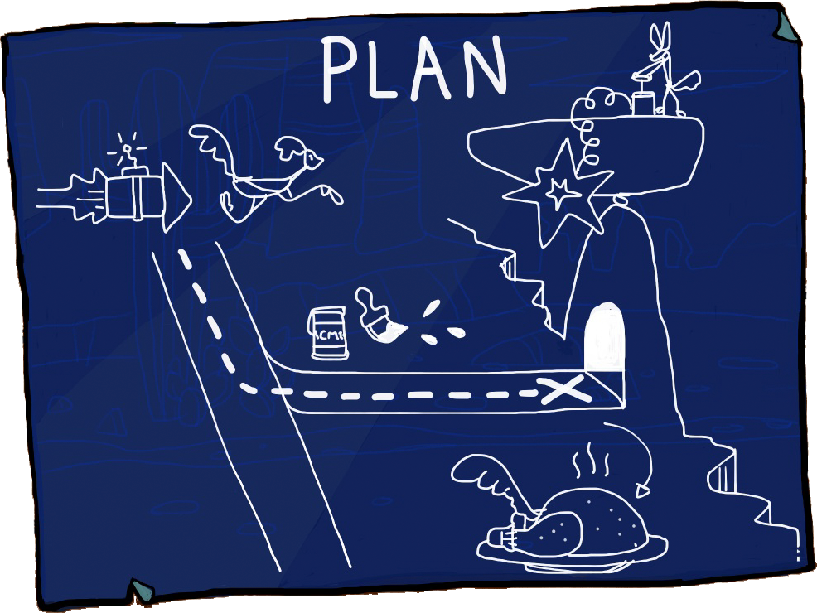
The blueprint!
Inheritance
Classical OOP
Prototype
Witchcraft
Sprinkle of demos
Q&A
Notes:
Let’s see what we got here..
On general a not so hard topic, however JS developers have spent as much time trying to explain inheritance in JS as Haskel developers trying to explain monads…

Slide 4


Slide 5
Inheritance
Notes:
If not else, it makes up for quite a lot shorter title ☺

Slide 6
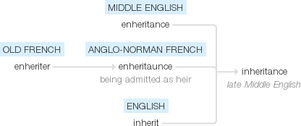
Inheritance /ɪnˈhɛrɪt(ə)ns/
noun
noun: inheritance; plural noun: inheritances

Slide 7

Notes:
This might be the best kind of inheritance … I wish it upon you all! So now let’s go to classical!

Slide 8
Types of inheritance
Single
Multiple
Multi-level
Hierarchical
Hybrid
Notes:
Please note I am not speaking about classes, just relationships.

Slide 9
A
B
Notes:
Single inheritance
where subclasses inherit the features of one superclass. A class acquires the properties of another class.
Good example:

Slide 10
A
B
C
Notes:
Multilevel inheritance
where a subclass is inherited from another subclass. It is not uncommon that a class is derived from another derived class as shown in the figure "Multilevel inheritance".
The class A serves as a base class for the derived class B, which in turn serves as a base class for the derived class C. The class Bis known as intermediate base class because it provides a link for the inheritance between A and C. The chain ABC is known as inheritance path.

Slide 11
C
A
B
Notes:
Hierarchical inheritance
where one class serves as a superclass (base class) for more than one sub class.

Slide 12
A
C
B
Notes:
Multiple inheritance
where one class can have more than one superclass and inherit features from all parent classes.
Horse + Man => !Centaur

Slide 13



Slide 14


Slide 15
A
B
AB
C
D
E
F
G
H
Notes:
Hybrid inheritance
a mix of two or more of the above types of inheritance.
Usually where our projects get the need of massive re-factoring…

Slide 16
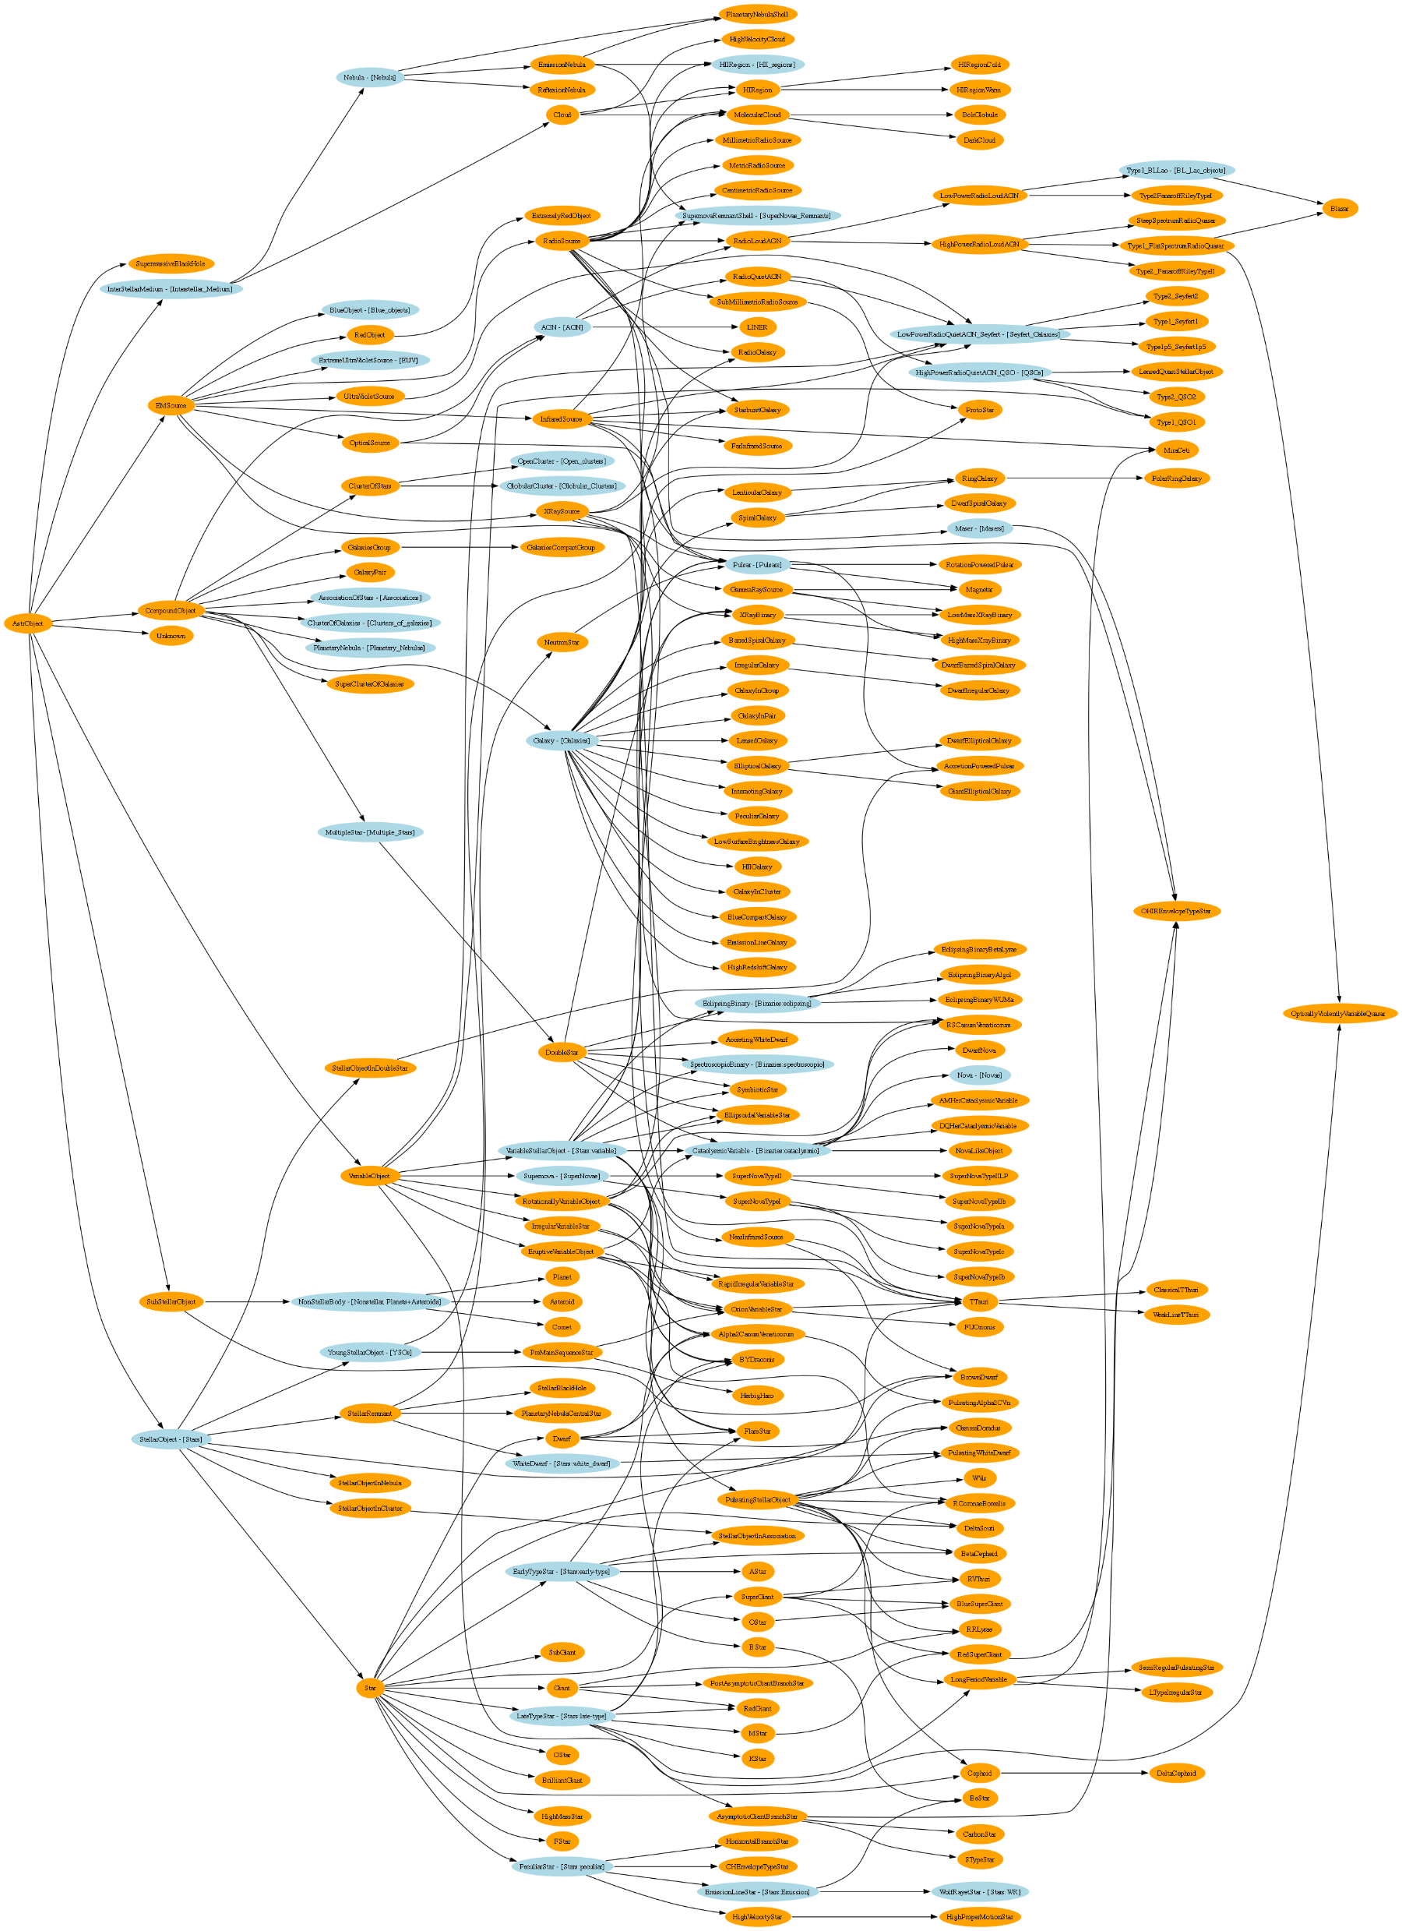

Slide 17
Classical inheritance
Notes:
If not else, it makes up for quite a lot shorter title ☺

Slide 18

What is “class”?
Theory
Design Pattern?
Class mechanics
Inheritance…
Notes:
Classes are a design pattern. Many languages provide syntax which enables natural class-oriented software design. JS also has a similar syntax, but it behaves very differently from what you're used to with classes in those other languages.
Classes mean copies.
When traditional classes are instantiated, a copy of behavior from class to instance occurs. When classes are inherited, a copy of behavior from parent to child also occurs.
Polymorphism (having different functions at multiple levels of an inheritance chain with the same name) may seem like it implies a referential relative link from child back to parent, but it's still just a result of copy behavior.
JavaScript does not automatically create copies (as classes imply) between objects.
The mixin pattern (both explicit and implicit) is often used to sort of emulate class copy behavior, but this usually leads to ugly and brittle syntax like explicit pseudo-polymorphism (OtherObj.methodName.call(this, ...)), which often results in harder to understand and maintain code.
Explicit mixins are also not exactly the same as class copy, since objects (and functions!) only have shared references duplicated, not the objects/functions duplicated themselves. Not paying attention to such nuance is the source of a variety of gotchas.
In general, faking classes in JS often sets more landmines for future coding than solving present real problems.

Slide 19

The blueprint parable
Stamp new objects
Copy != Link

Slide 20


Slide 21

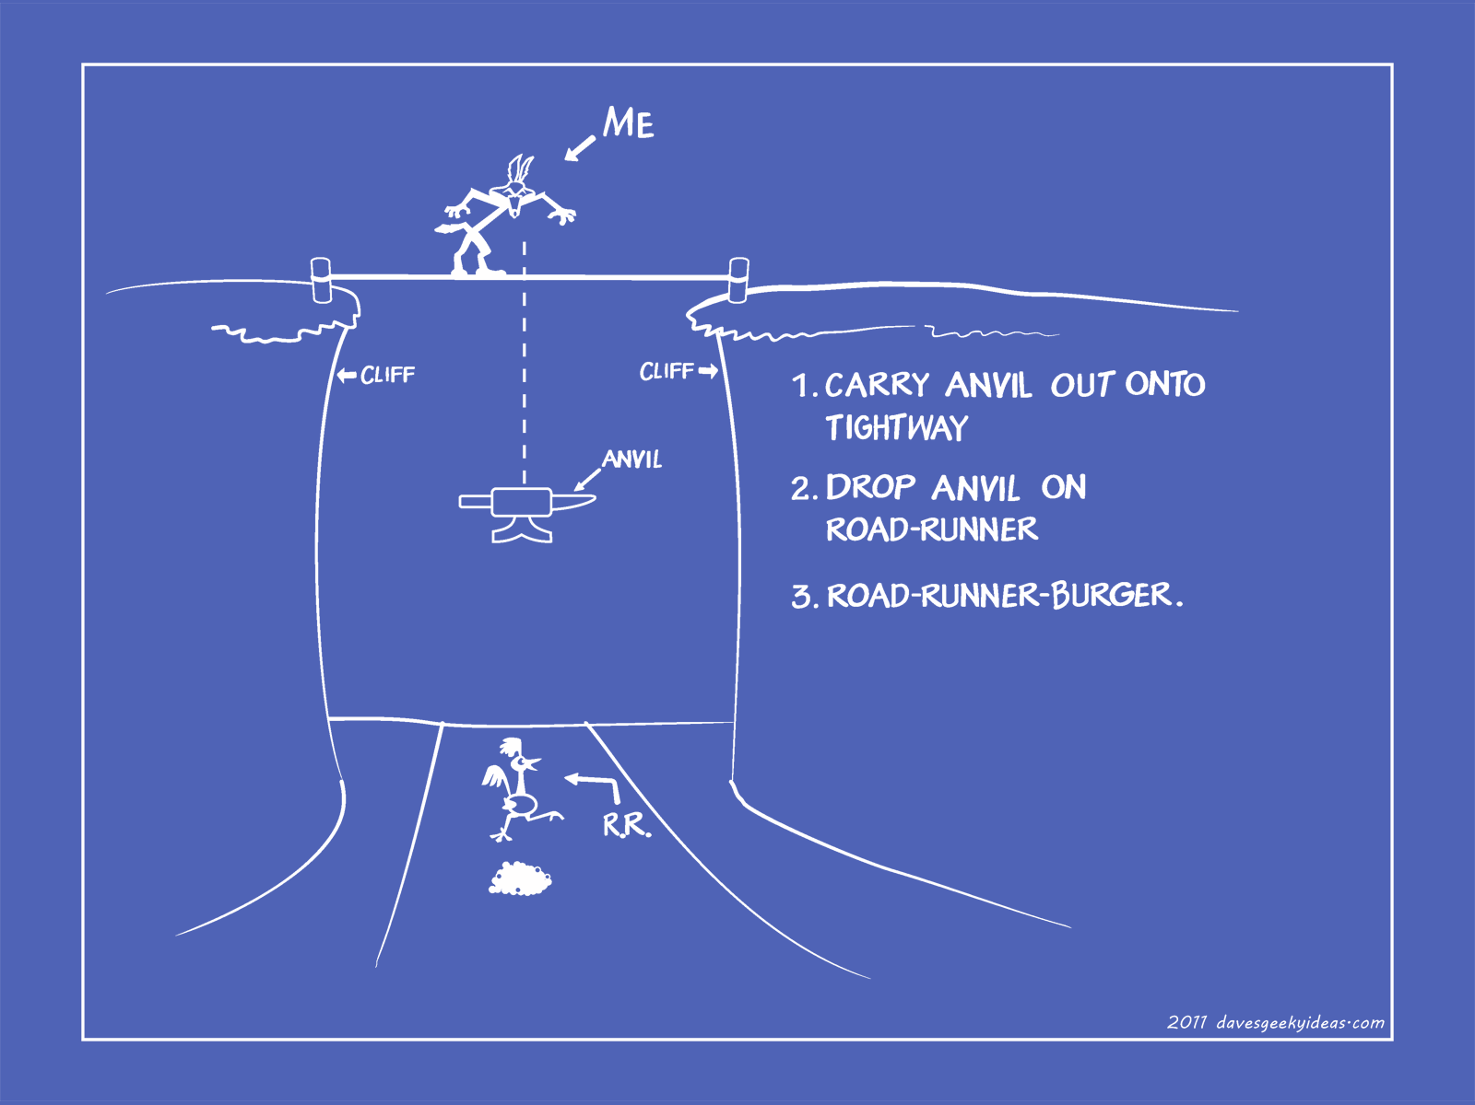

Slide 22

JS Class syntax
Class
Constructor
Super
Extends

Slide 23
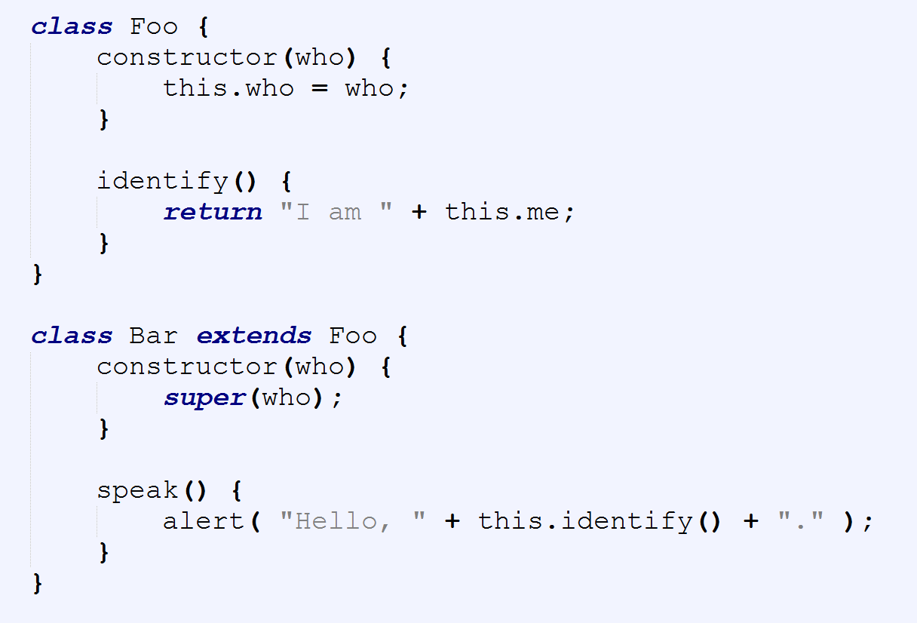
Notes:
Mention the fact that you can only do
Single
Multilevel
Inheritance and not multiple

Slide 24
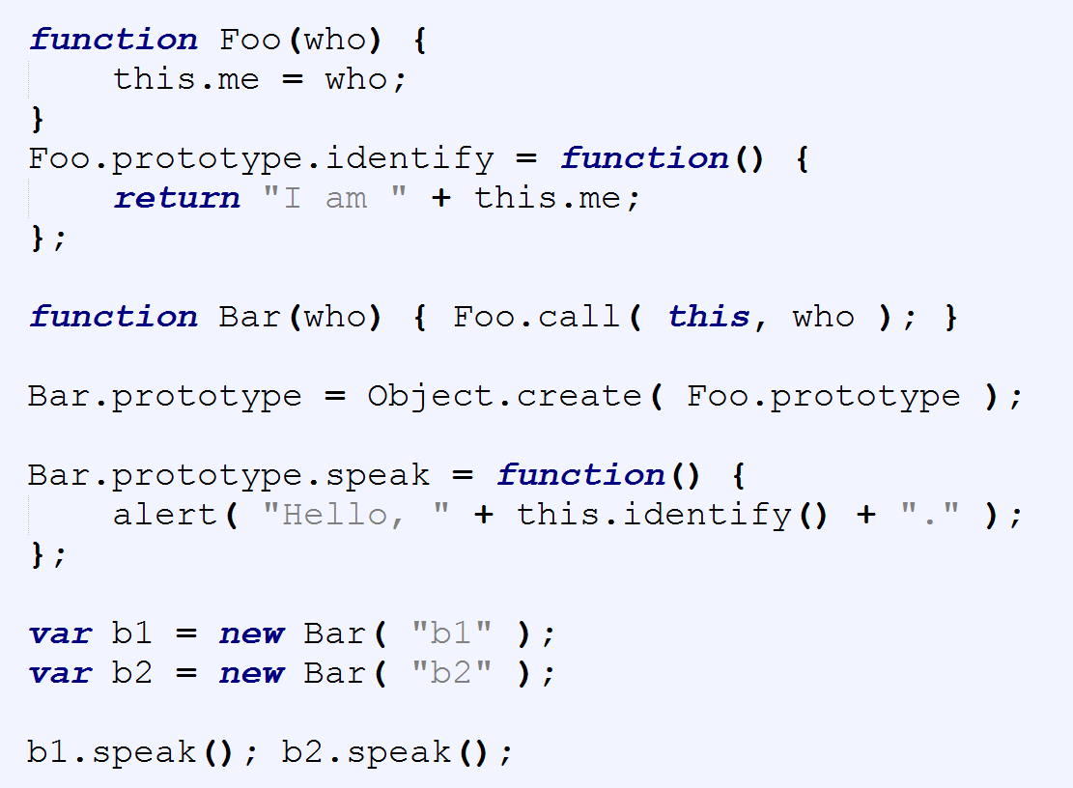

Slide 25
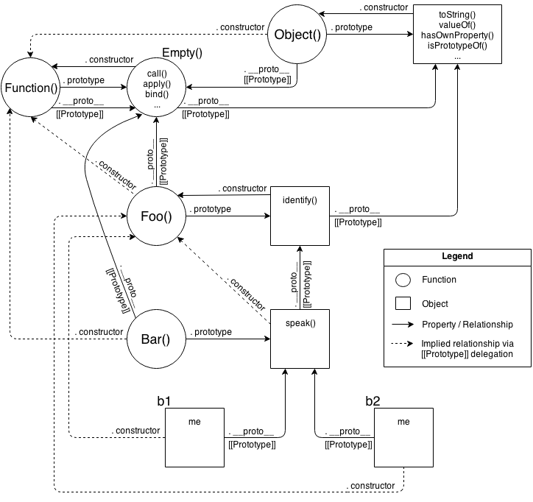

Slide 26


Slide 27
Convention’s got a name!
I hate JavaScript
Why can’t we have nice things
Witchcraft
Happy debugging, f#@$&%s
Why did I leave Cobol behind…
I should start herding sheep
Magic

Slide 28
Quick note!

Slide 29
JS Objects
Literals
Constructed
“this”
Notes:
What's this?
this is not an author-time binding but a runtime binding
It is contextual based on the conditions of the function's invocation. this binding has nothing to do with where a function is declared, but has instead everything to do with the manner in which the function is called.
When a function is invoked, an activation record (execution context) is created.
where the function was called from (the call-stack)
how the function was invoked
what parameters were passed
one of the properties of this record is the this reference which will be used for the duration of that function's execution.
Review
constant source of confusion
trial-and-error and blind copy-n-paste from Stack Overflow answers
To learn this, you first have to learn what this is not, despite any assumptions or misconceptions that may lead you down those paths. this is neither a reference to the function itself, nor is it a reference to the function's lexical scope.
this is actually a binding that is made when a function is invoked, and what it references is determined entirely by the call-site where the function is called.
Determining the this binding for an executing function requires finding the direct call-site of that function. Once examined, four rules can be applied to the call-site, in this order of precedence:
1. Called with new? Use the newly constructed object.
2. Called with call or apply (or bind)? Use the specified object.
3. Called with a context object owning the call? Use that context object.
4. Default: undefined in strict mode, global object otherwise.
5. ES6 arrow functions bind to the lexical scope
Be careful of accidental/unintentional invoking of the default binding rule.

Slide 30
Prototypes
Notes:
If not else, it makes up for quite a lot shorter title ☺

Slide 31
[[Proto wut?]]
Just an object
Internal property
Notes:
Objects in JavaScript have an internal property, denoted in the specification as [[Prototype]], which is simply a reference to another object. Almost all objects are given a non-null value for this property, at the time of their creation.
1. Objects may be created in various ways including via a literal notation or via constructors which create objects and then execute code that initializes all or part of them by assigning initial values to their properties. Each constructor is a function that has a property named "prototype" that is used to implement prototype‑ based inheritance and shared properties. Objects are created by using constructors in new expressions
2. Every object created by a constructor has an implicit reference (called the object's prototype) to the value of its constructor's "prototype" property.
3. When a is created by calling new Foo(), one of the things that happens is that a gets an internal [[Prototype]] link to the object that Foo.prototype is pointing at.
In class-oriented languages, multiple copies (aka, "instances") of a class can be made, like stamping something out from a mold. As we saw in Chapter 4, this happens because the process of instantiating (or inheriting from) a class means, "copy the behavior plan from that class into a physical object", and this is done again for each new instance.
But in JavaScript, there are no such copy-actions performed. You don't create multiple instances of a class. You can create multiple objects that [[Prototype]] link to a common object. But by default, no copying occurs, and thus these objects don't end up totally separate and disconnected from each other, but rather, quite linked.
new Foo() results in a new object (we called it a), and that new object a is internally [[Prototype]] linked to theFoo.prototype object.
We end up with two objects, linked to each other. That's it. We didn't instantiate a class. We certainly didn't do any copying of behavior from a "class" into a concrete object. We just caused two objects to be linked to each other.
But where exactly does the [[Prototype]] chain "end"?
The top-end of every normal [[Prototype]] chain is the built-in Object.prototype. This object includes a variety of common utilities used all over JS, because all normal (built-in, not host-specific extension) objects in JavaScript "descend from" (aka, have at the top of their [[Prototype]] chain) the Object.prototype object.
Some utilities found here you may be familiar with include .toString() and .valueOf(). In Chapter 3, we introduced another: .hasOwnProperty(..). And yet another function on Object.prototype you may not be familiar with, but which we'll address later in this chapter, is .isPrototypeOf(..).

Slide 32
Object creation
Literal creation
Constructor creation
Notes:
1. Objects may be created in various ways including via a literal notation or via constructors which create objects and then execute code that initializes all or part of them by assigning initial values to their properties. Each constructor is a function that has a property named "prototype" that is used to implement prototype‑ based inheritance and shared properties. Objects are created by using constructors in new expressions
2. Every object created by a constructor has an implicit reference (called the object's prototype) to the value of its constructor's "prototype" property.
3. When a is created by calling new Foo(), one of the things that happens is that a gets an internal [[Prototype]] link to the object that Foo.prototype is pointing at.

Slide 33
Delegation
Behavioral delegation
Mutual delegation
Debugging
Notes:
To properly focus our thoughts on how to use [[Prototype]] in the most straightforward way, we must recognize that it represents a fundamentally different design pattern from classes (see Chapter 4).
Note: Some principles of class-oriented design are still very valid, so don't toss out everything you know (just most of it!). For example, encapsulation is quite powerful, and is compatible (though not as common) with delegation.
We need to try to change our thinking from the class/inheritance design pattern to the behavior delegation design pattern. If you have done most or all of your programming in your education/career thinking in classes, this may be uncomfortable or feel unnatural. You may need to try this mental exercise quite a few times to get the hang of this very different way of thinking.
Behavior Delegation means: let some object (XYZ) provide a delegation (to Task) for property or method references if not found on the object (XYZ).
This is an extremely powerful design pattern, very distinct from the idea of parent and child classes, inheritance, polymorphism, etc. Rather than organizing the objects in your mind vertically, with Parents flowing down to Children, think of objects side-by-side, as peers, with any direction of delegation links between the objects as necessary.
Note: Delegation is more properly used as an internal implementation detail rather than exposed directly in the API interface design. In the above example, we don't necessarily intend with our API design for developers to call XYZ.setID() (though we can, of course!). We sorta hide the delegation as an internal detail of our API, where XYZ.prepareTask(..) delegates to Task.setID(..). See the "Links As Fallbacks?" discussion in Chapter 5 for more detail.

Slide 34
Witchcraft

Slide 35
Shadowing
Object properties
Prototype chain access
Implicit properties setting
Notes:
Whenever a property is accessed, the engine invokes internal default [[Get/Set]] operation which not only looks for the property directly on the object, but which will traverse the [[Prototype]] chain if not found.
Properties have characteristics that can be controlled through property descriptors, such as:
Writable
Configurable
Enumerable
In addition, objects can have their mutability controlled to various levels of immutability:
Object.preventExtensions(..)
Object.seal(..)
Object.freeze(..)
Properties don't have to contain values -- they can be "accessor properties" as well, with getters/setters. They can also be either enumerable or not, which controls if they show up in for..in loop iterations, for instance.
1. If a normal data accessor (see Chapter 3) property named foo is found anywhere higher on the [[Prototype]] chain, and it's not marked as read-only (writable:false) then a new property called foo is added directly to myObject, resulting in a shadowed property.
2. If a foo is found higher on the [[Prototype]] chain, but it's marked as read-only (writable:false), then both the setting of that existing property as well as the creation of the shadowed property on myObject are disallowed. If the code is running in strict mode, an error will be thrown. Otherwise, the setting of the property value will silently be ignored. Either way, no shadowing occurs.
3. If a foo is found higher on the [[Prototype]] chain and it's a setter (see Chapter 3), then the setter will always be called. No foo will be added to (aka, shadowed on) myObject, nor will the foo setter be redefined.

Slide 36
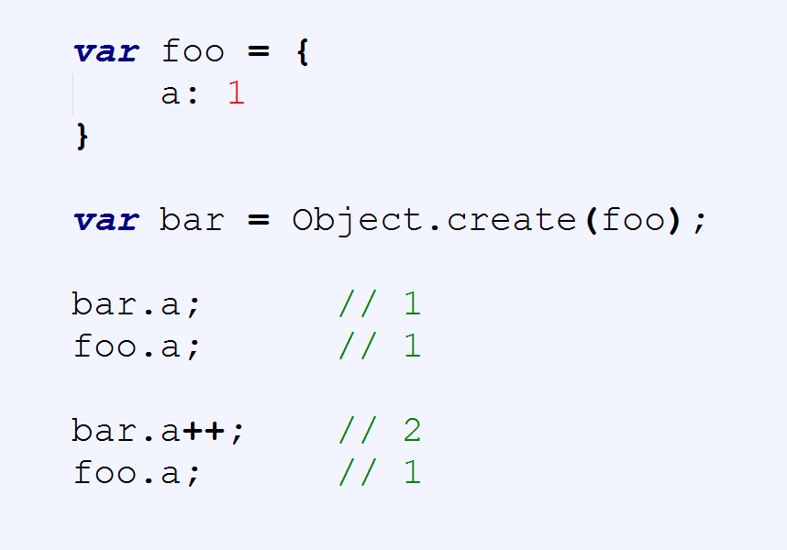

Slide 37
Introspection
Relate instances
Find out who is who

Slide 38
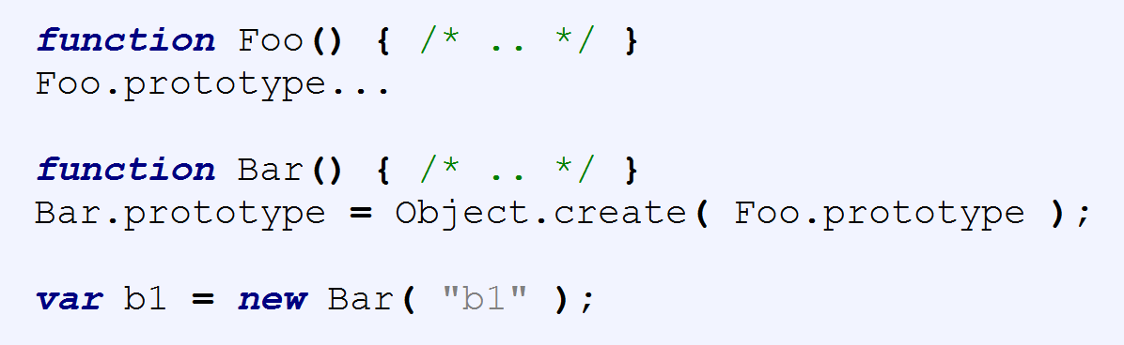

Slide 39
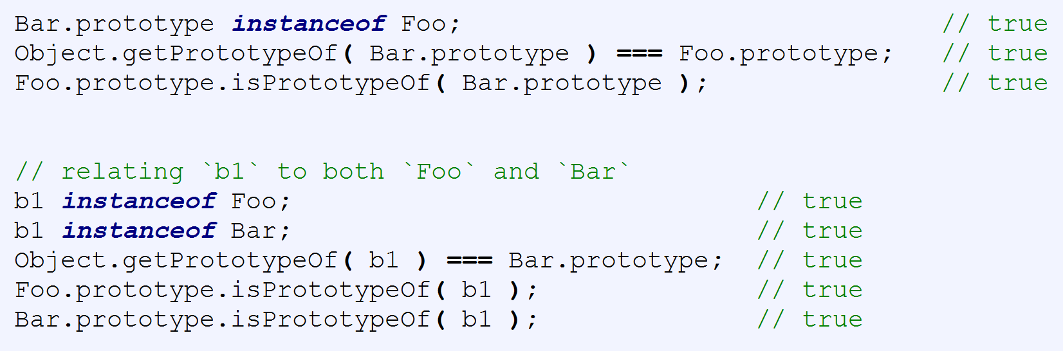

Slide 40
OLOO to the rescue?
Simpler syntax
Cutting the middle man
Notes:
With this OLOO-style approach, we don't think of Widget as a parent and Button as a child. Rather, Widget is just an objectand is sort of a utility collection that any specific type of widget might want to delegate to, and Button is also just a stand-alone object (with a delegation link to Widget, of course!).
// relating `Foo` and `Bar` to each other
Foo.isPrototypeOf( Bar ); // true
Object.getPrototypeOf( Bar ) === Foo; // true
// relating `b1` to both `Foo` and `Bar`
Foo.isPrototypeOf( b1 ); // true
Bar.isPrototypeOf( b1 ); // true
Object.getPrototypeOf( b1 ) === Bar; // true

Slide 41
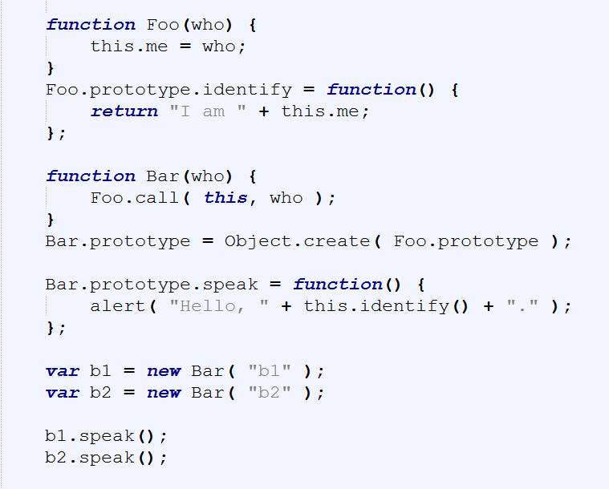
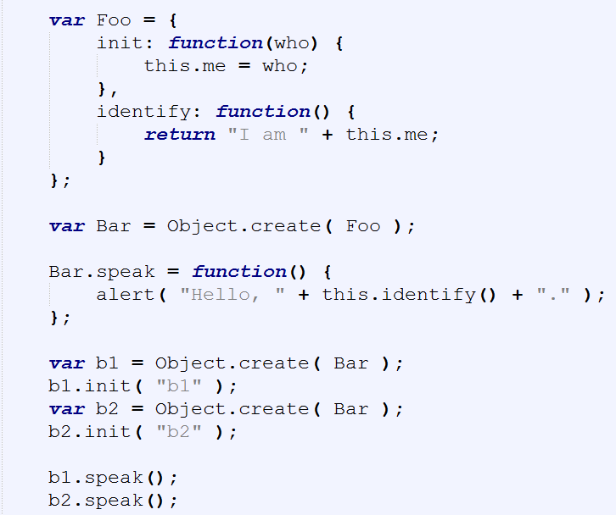

Slide 43
Notes:
We take exactly the same advantage of [[Prototype]] delegation from b1 to Bar to Foo as we did in the previous snippet between b1, Bar.prototype, and Foo.prototype. We still have the same 3 objects linked together.
But, importantly, we've greatly simplified all the other stuff going on, because now we just set up objects linked to each other, without needing all the cruft and confusion of things that look (but don't behave!) like classes, with constructors and prototypes and new calls.
Ask yourself: if I can get the same functionality with OLOO style code as I do with "class" style code, but OLOO is simpler and has less things to think about, isn't OLOO better?
Let's examine the mental models involved between these two snippets.
First, the class-style code snippet implies this mental model of entities and their relationships:

Slide 44
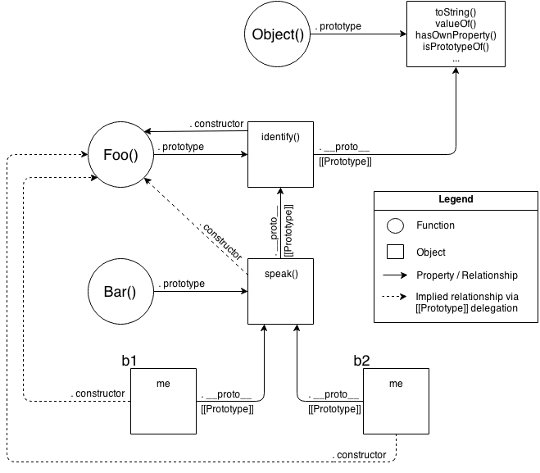
Notes:
Actually, that's a little unfair/misleading, because it's showing a lot of extra detail that you don't technically need to know at all times (though you do need to understand it!).
One take-away is that it's quite a complex series of relationships. But another take-away: if you spend the time to follow those relationship arrows around, there's an amazing amount of internal consistency in JS's mechanisms.
For instance, the ability of a JS function to access call(..), apply(..), and bind(..) (see Chapter 2) is because functions themselves are objects, and function-objects also have a [[Prototype]] linkage, to the Function.prototype object, which defines those default methods that any function-object can delegate to.
JS can do those things, and you can too!.
OK, let's now look at a slightly simplified version of that diagram which is a little more "fair" for comparison -- it shows only the relevant entities and relationships.
Still pretty complex, eh? The dotted lines are depicting the implied relationships when you setup the "inheritance" betweenFoo.prototype and Bar.prototype and haven't yet fixed the missing .constructor property reference (see "Constructor Redux" in Chapter 5).
Even with those dotted lines removed, the mental model is still an awful lot to juggle every time you work with object linkages.

Slide 45
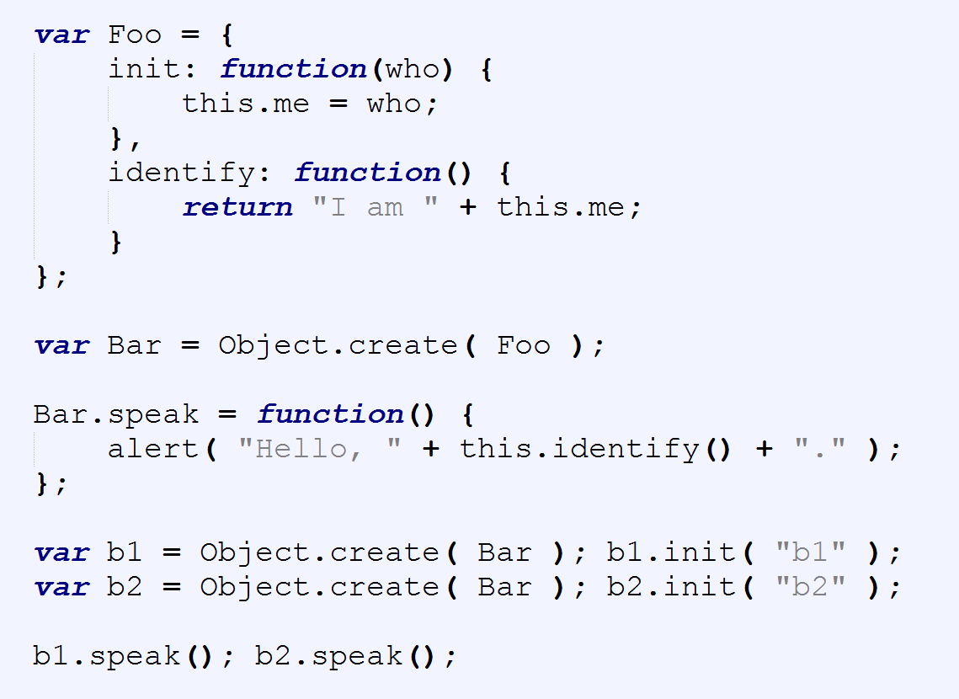

Slide 46
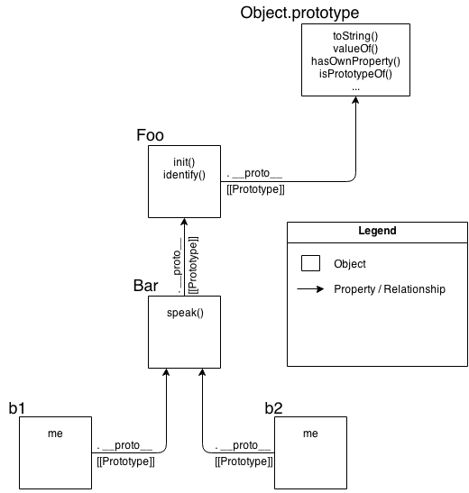
Notes:
We take exactly the same advantage of [[Prototype]] delegation from b1 to Bar to Foo as we did in the previous snippet between b1, Bar.prototype, and Foo.prototype. We still have the same 3 objects linked together.
But, importantly, we've greatly simplified all the other stuff going on, because now we just set up objects linked to each other, without needing all the cruft and confusion of things that look (but don't behave!) like classes, with constructors and prototypes and new calls.
Ask yourself: if I can get the same functionality with OLOO style code as I do with "class" style code, but OLOO is simpler and has less things to think about, isn't OLOO better?
Let's examine the mental models involved between these two snippets.
First, the class-style code snippet implies this mental model of entities and their relationships:
As you can see comparing them, it's quite obvious that OLOO-style code has vastly less stuff to worry about, because OLOO-style code embraces the fact that the only thing we ever really cared about was the objects linked to other objects.
All the other "class" cruft was a confusing and complex way of getting the same end result. Remove that stuff, and things get much simpler (without losing any capability).

Slide 47
Compromise?
IIFE
OLOO
Object composition
Notes:
Classes and inheritance are a design pattern you can choose, or not choose, in your software architecture. Most developers take for granted that classes are the only (proper) way to organize code, but here we've seen there's another less-commonly talked about pattern that's actually quite powerful: behavior delegation.
Behavior delegation suggests objects as peers of each other, which delegate amongst themselves, rather than parent and child class relationships. JavaScript's [[Prototype]] mechanism is, by its very designed nature, a behavior delegation mechanism. That means we can either choose to struggle to implement class mechanics on top of JS (see Chapters 4 and 5), or we can just embrace the natural state of [[Prototype]] as a delegation mechanism.
When you design code with objects only, not only does it simplify the syntax you use, but it can actually lead to simpler code architecture design.
OLOO (objects-linked-to-other-objects) is a code style which creates and relates objects directly without the abstraction of classes. OLOO quite naturally implements [[Prototype]]-based behavior delegation.

Slide 48
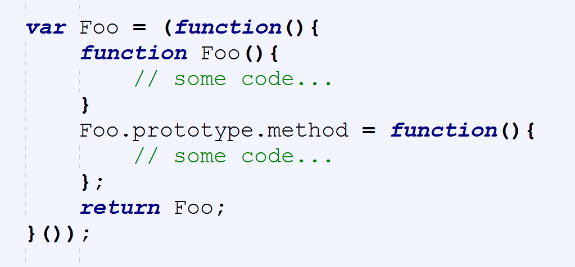

Slide 49
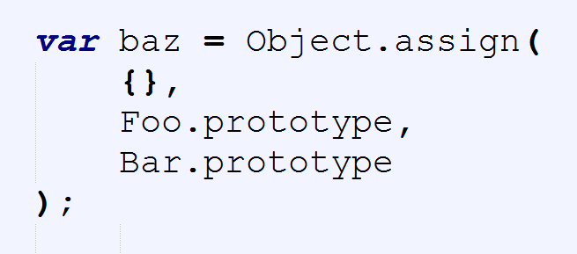

Slide 50
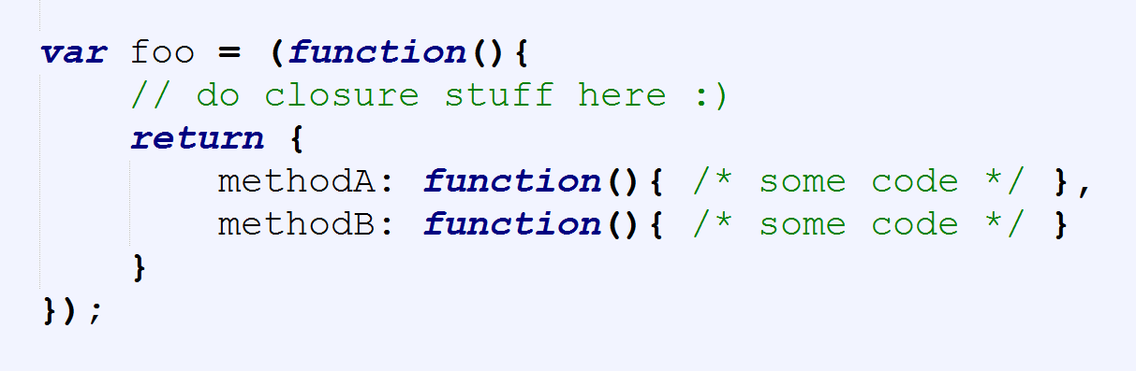
Simplify further

Slide 51
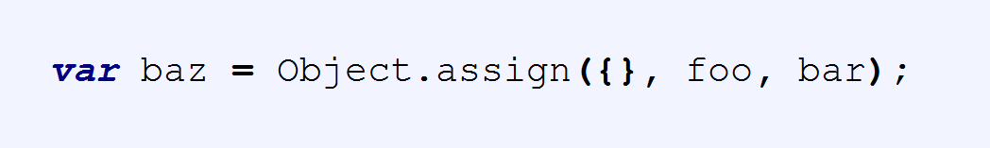
Notes:
Classes and inheritance are a design pattern you can choose, or not choose, in your software architecture.
Most developers take for granted that classes are the only (proper) way to organize code, but here we've seen there's another less-commonly talked about pattern that's actually quite powerful: behavior delegation.
Behavior delegation suggests objects as peers of each other, which delegate amongst themselves, rather than parent and child class relationships. JavaScript's [[Prototype]] mechanism is, by its very designed nature, a behavior delegation mechanism.
That means we can either choose to struggle to implement class mechanics on top of JS (see Chapters 4 and 5), or we can just embrace the natural state of [[Prototype]] as a delegation mechanism.
When you design code with objects only, not only does it simplify the syntax you use, but it can actually lead to simpler code architecture design.
OLOO (objects-linked-to-other-objects) is a code style which creates and relates objects directly without the abstraction of classes. OLOO quite naturally implements [[Prototype]]-based behavior delegation.

Slide 52
Demos?

Slide 53


Slide 54


Slide 55
What did we cover?
Inheritance
Classical inheritance
Prototypes
Delegation
Shadowing
Introspection
OLOO
Composition

Slide 56


Slide 57


Slide 58

Connect ☺
LinkedIn: https://goo.gl/CRRJ2Y
Mail: martin.c@sbtech.com
Github: https://github.com/mchaov

